Slide 1
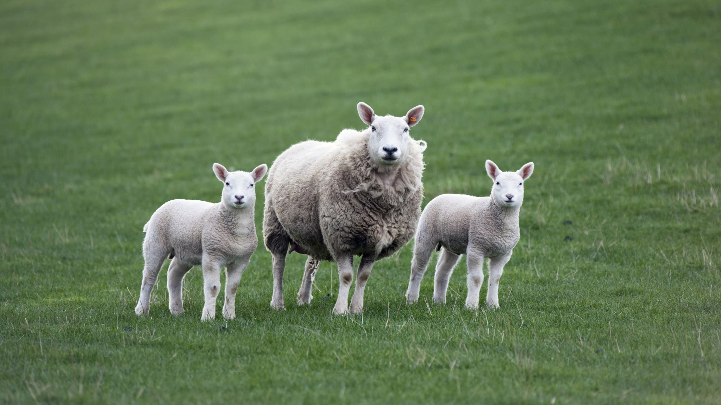
Learning intentions (LI): Revise SPICESS, SHEEP T, PQE & Key Concepts (KC)
Success criteria (SC): Recall SPICESS from previous lesson. List and provide examples of SPICESS, SHEEPT & PQE

Slide 2
Define the word Geography?
Geography is the study of places and the relationships between people and their environments.

Slide 3
Divided into 2 branches
Physical Geography
Human Geography

Slide 4
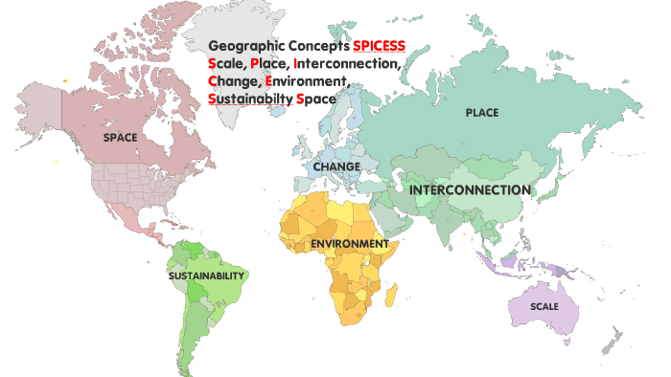
SPICESS

Slide 5

Examples for SPICESS
Textbook Jacaranda pages 356-360

Slide 6
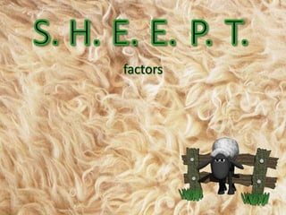
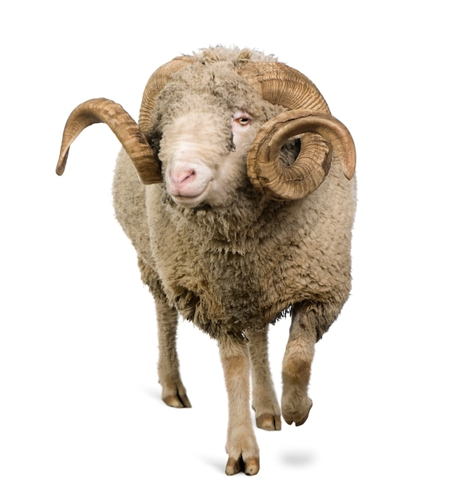

Slide 7
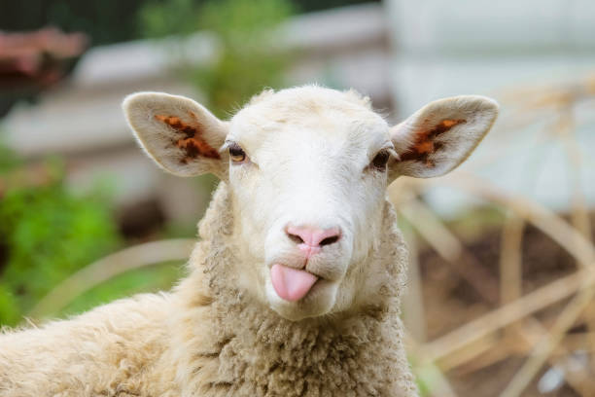
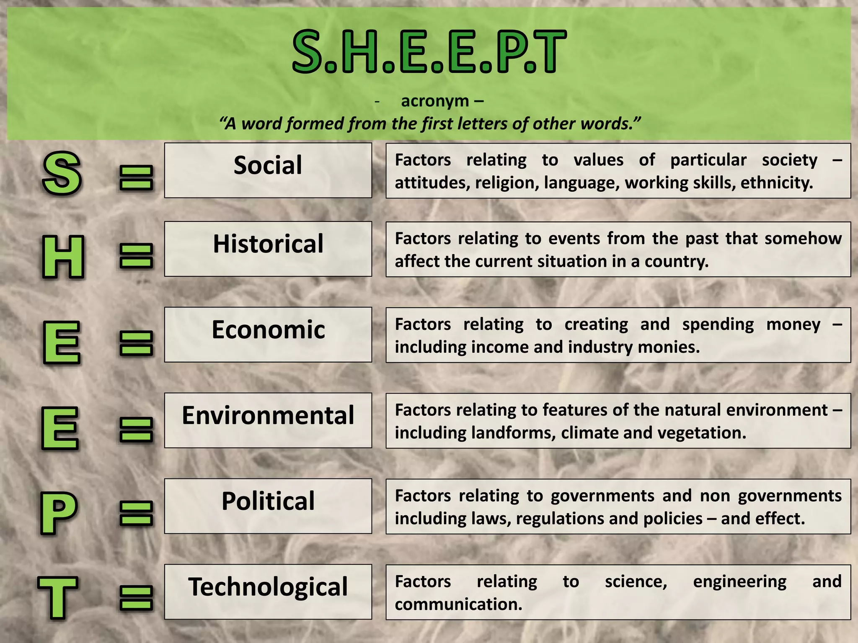

Slide 8
PQE- Method used by geographers to analyse data and reach conclusions
P | Patterns -provide a general overview of things that stand out and form patterns
Q | Quantify -add specific and accounts information to define and explain patterns - Specific details might be statistics, amounts, sizes and locations
E | Expectations: look for, describe and try to explain any expectations to the pattern
Notes:
https://www.youtube.com/watch?app=desktop&v=5NJMtzA6Ai8

